Slide 1
LOGISTIC REGRESSION
CASE STUDY
- Gautam Sondhi

Slide 2
Introduction
This case study is on Predictive analysis using the regression technique called Logistic Regression.
A credit card company wants to predict the bad customers for which a model is to be made using the regression technique .
We our provided with old customers data involving the details like Region , Education , Occupation , Monthly Income etc.. . We use these variables to create Predictive Modeling .

Slide 3
Data Exploration And Preparation
Missing value Treatment
Outlier Treatment
Converting Qualitative to Quantitative
Creating Dummy variables

Slide 4
Missing Value Treatment
First , Check for dependent variable as missing values in the dependent variable must not be imputed . Hence , we delete them
/* Found two rows with missing value in Dependent variable which we will delete from our dataset*/
data card.creditcard1;
set card.creditcard;
if npa_status=" " then delete;
run;

Slide 5
Missing Value Treatment
Converting Character variable Monthlyincome and NumberOfDependents to numeric variable produced some missing values .
Check for Missing value using Proc Mean :
We will treat these values with Similar Case Imputation - Identifying the similar observation with respect to gender and education for monthlyincome and impute the average.
Bar Graph on Education with number of Male and Female on Next Slide
SAS Code Present in Path : Y:\Logistic Graded Assignment
Variable | N | nmiss
monthlyincome | 118474 | 29609
NumberOfDependents | 144190 | 3893

Slide 6
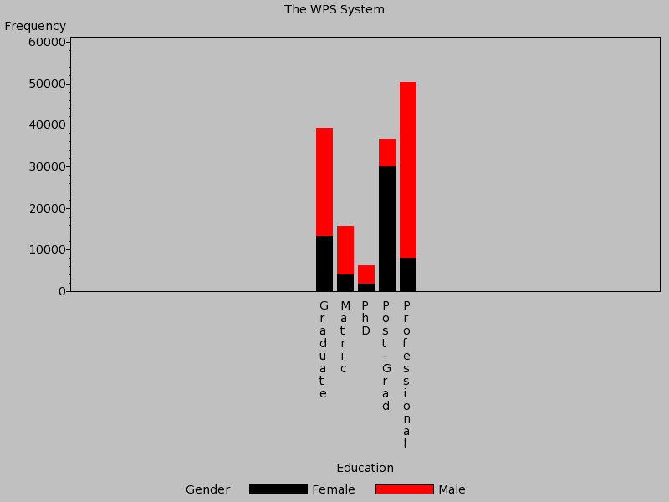
Vertical Bar Graph
Visualization of Education spread across Male and Female

Slide 7
Missing Value Treatment – Mean Imputation
We have calculated mean as per gender and education to be more precise , as per follows , and imputed these means to variable monthlyincome in the data .
The WPS System
The MEANS Procedure
Analysis Variable: monthlyincome
Gender | Education | N Obs | Mean
Female | Graduate | 13256 | 6642.29
 | Matric | 3928 | 6727.26
 | PhD | 1801 | 6551.89
 | Post-Grad | 29969 | 6812.82
 | Professional | 7983 | 6592.50
Male | Graduate | 25986 | 6684.68
 | Matric | 11688 | 6648.29
 | PhD | 4423 | 6518.20
 | Post-Grad | 6772 | 6982.01
 | Professional | 42277 | 6667.85

Slide 8
Outlier Treatment
Checking outliers for numeric variables using Proc Univariate and Proc gplot .
I have come with the following conclusion with respect to the outliers
1) Delete whose age =0
2) Delete NumberOfTime30_59DaysPastDueNotW > 90
3) Delete NumberOfOpenCreditLinesAndLoans whose monthly salary is greater than 1000000
4) Delete NumberOfTimes90DaysLate>90
5) Delete NumberRealEstateLoansOrLines>20
6) Delete NumberOfTime60_89DaysPastDueNotWorse>90
7) Delete NumberOfDependents>9
8) Delete monthly income =0 & grester than 1000000
SAS Code Present in Path : Y:\Logistic Graded Assignment

Slide 9
Converting Qualitative to Quantitative
Created Dummy Variable for following :
Region
Education
Occupation
Gender

Slide 10
Model Building
Split the data into two following datasets :
Training Dataset
Validation Dataset
/*Model Building - Splitting the data*/
proc surveyselect data=card.creditcard_final
method = SRS out=samp1 samprate=0.70 outall;
run;
/*Training and validate datasets*/
data card.creditcard_train card.creditcard_validate;
set samp1;
if selected = 0 then output card.creditcard_train;
else if selected = 1 then output card.creditcard_validate;
run;

Slide 11
Logistic Regression Analysis
Starting with the analysis , we ran Proc logistic with all the variable to interpret the outcome and find out significant and insignificant variable .
Ran multiple iterations by removing insignificant , intuitively incorrect variable .
Came up with the following final model :
/*Final Model */
proc logistic data= card.creditcard_train descending outmodel=dmm;
model NPA_Status = RevolvingUtilizationOfUnsecuredL
age
gen_new north east west
house_own
self_emp officer_1 officer_2 officer_3
edu_prof edu_grad edu_postgrd
/*debtratio */
NumberOfOpenCreditLinesAndLoans
NumberRealEstateLoansOrLines
NumberOfTime60_89DaysPastDueNotW
monthlyincome
NumberOfDependents / ctable lackfit;
score out=dmp;
run;

Slide 12
Revising Model with Validation Dataset
Model needs to validated against the validation dataset , we get results similar or somewhat similar to training dataset .
If the output has similar coefficients and significant variable , we can validate the model .
Running the same model with validation data :
/*Validation Data*/
proc logistic data= card.creditcard_validate descending outmodel=dmm;
model NPA_Status = RevolvingUtilizationOfUnsecuredL
age
gen_new north east west
house_own
self_emp officer_1 officer_2 officer_3
edu_prof edu_grad edu_postgrd
/*debtratio */
NumberOfOpenCreditLinesAndLoans
NumberRealEstateLoansOrLines
NumberOfTime60_89DaysPastDueNotW
monthlyincome
NumberOfDependents / ctable lackfit;
score out=dmp;
run;

Slide 13
Output : Model fit statistics
Response Profile
Ordered Value | NPA_Status | Total Frequency
1 | 1 | 6798
2 | 0 | 96698
Probability modeled is NPA_Status='1'.
Model Fit Statistics
Criterion | Intercept only | Intercept and Covariates
AIC | 50161.981 | 35711.844
SC | 50171.529 | 35902.789
-2 Log L | 50159.981 | 35671.844
Testing Global Null Hypothesis: BETA=0
Test | Chi-Square | DF | Pr > Chi-Square
Likelihood Ratio | 14488.1377 | 19 | <.0001
Score | 18512.8663 | 19 | <.0001
Wald | 9740.6591 | 19 | <.0001

Slide 14
Output: Beta Coefficients and Significant variables
Analysis of Maximum Likelihood Estimates
Parameter | DF | Estimate | Standard Error | Wald Chi-Square | Pr > ChiSq
Intercept | 1 | -2.2862 | 0.0938 | 593.5813 | <.0001
RevolvingUtilizationOfUnsecuredL | 1 | 2.1813 | 0.0390 | 3132.7468 | <.0001
age | 1 | -0.0175 | 0.00115 | 233.3007 | <.0001
gen_new | 1 | -0.2948 | 0.0365 | 65.3848 | <.0001
north | 1 | 1.2416 | 0.0458 | 733.7108 | <.0001
east | 1 | 0.2762 | 0.0695 | 15.8002 | <.0001
west | 1 | 2.3512 | 0.0407 | 3341.0405 | <.0001
house_own | 1 | -0.3706 | 0.0345 | 115.0759 | <.0001
self_emp | 1 | -0.4952 | 0.0456 | 117.8518 | <.0001
officer_1 | 1 | -0.4541 | 0.0714 | 40.4787 | <.0001
officer_2 | 1 | 0.2540 | 0.0646 | 15.4406 | <.0001
officer_3 | 1 | -0.4314 | 0.0683 | 39.8985 | <.0001
edu_prof | 1 | -1.9049 | 0.0517 | 1357.5569 | <.0001
edu_grad | 1 | -1.9131 | 0.0549 | 1216.2345 | <.0001
edu_postgrd | 1 | -1.1928 | 0.0594 | 403.4265 | <.0001
NumberOfOpenCreditLinesAndLoans | 1 | 0.0270 | 0.00315 | 73.5580 | <.0001
NumberRealEstateLoansOrLines | 1 | 0.1005 | 0.0139 | 52.2341 | <.0001
NumberOfTime60_89DaysPastDueNotW | 1 | 1.1063 | 0.0284 | 1517.0589 | <.0001
monthlyincome | 1 | -0.00003 | 3.86E-6 | 51.9207 | <.0001
NumberOfDependents | 1 | 0.0687 | 0.0124 | 30.6918 | <.0001

Slide 15
Concordance table
Association of Predicted Probabilities and Observed Responses
Percent Concordant | 87.0 | Somer's D | 0.747
Percent Discordant | 12.4 | Gamma | 0.751
Percent Tied | 0.6 | Tau-a | 0.092
Pairs | 6.5735E8 | c | 0.873

Slide 16
Ranking the Model Excel Sheet present in path :Y:\Logistic Graded Assignment
 | NPA_STATUS |  |  |  |  |  | Commulative |  |  | Commulative |  | Lift %
Number of observations | 0(Good Customers) | 1 (Bad customers) |  | Expected Default | Observed Default |  | Expected default | Observed default |  | Random Expected % | Model Predicted%
10349 | 6638 | 3711 |  | 680 | 3711 |  | 680 | 3711 |  | 10 | 54.5895852 | 545.8959
10350 | 9028 | 1322 |  | 680 | 1322 |  | 1360 | 5033 |  | 20 | 74.0364813 | 370.1824
10350 | 9694 | 656 |  | 680 | 656 |  | 2040 | 5689 |  | 30 | 83.6863783 | 278.9546
10349 | 9954 | 395 |  | 680 | 395 |  | 2720 | 6084 |  | 40 | 89.4969109 | 223.7423
10350 | 10083 | 267 |  | 680 | 267 |  | 3400 | 6351 |  | 50 | 93.4245366 | 186.8491
10350 | 10164 | 186 |  | 680 | 186 |  | 4080 | 6537 |  | 60 | 96.1606355 | 160.2677
10349 | 10220 | 129 |  | 680 | 129 |  | 4760 | 6666 |  | 70 | 98.0582524 | 140.0832
10350 | 10274 | 76 |  | 680 | 76 |  | 5440 | 6742 |  | 80 | 99.1762283 | 123.9703
10350 | 10311 | 39 |  | 680 | 39 |  | 6120 | 6781 |  | 90 | 99.7499264 | 110.8333
10349 | 10332 | 17 |  | 680 | 17 |  | 6800 | 6798 |  | 100 | 100 | 100
103496 | 96698 | 6798

Slide 17
Gain Chart

Slide 18
THANK YOU
SAS Code and Excel sheet present in file :
Y:\Logistic Graded Assignment

